Slide 1

Social Media Website for Special Children CSE 299 (Section: 23) Supervisor Dr. Ahsanur Rahman (Ara2) Assistant Professor Submitted By: Name: Fahrin Hossain Sunaira, ID: 2031856642 Name: Farasha Shamma Yussouf, ID: 2031250642

Slide 2
Introduction Our project mainly aims to address and limit several challenges faced by parents of special children every day, such as: -Parents of special children often feel isolated and lack access to a supportive community where they can connect with others who understand their unique challenges and experiences. This can lead to feelings of loneliness and frustration in the parents, thus we aimed to provide a friendly community where the parents can communicate with each other anytime and get support from each other. -The parents can post about the success stories of their child, making other parents gain motivation from them, and gather hope for their child too. -In our website, we had separate sections where we could find out about books, games dedicated to special children which can stimulate their brain power. Also, there are sections where parents can get to know about the events occurring around them catered for their special children, such as “International Autism Day”, and there is another important section where parents can find job offerings centered for special children only. There is a mood section too where parents can learn about what to do when their child is going through a particular mood, for example, happy or angry.

Slide 3
Motivation As we know, there are still parts of the world where the special children are neglected of their rights from a very young age, which leaves the parents very worried about them. Through our project we want to create a more inclusive society that embraces and supports special children and their families can foster empathy, reduce stigmatization, and promote equal opportunities for all. By empowering parents with knowledge and resources, our project can potentially enhance the quality of interventions and services provided to special children, leading to improved outcomes and long-term societal benefits. The motivation behind this project also results from a personal encounter of a similar problem, which was faced by the parents of a special child, aged 20. Since she was diagnosed to be on the autism spectrum, her parents have been heartbroken seeing their child suffering and failing to grasp onto the world like other children her age. So, we want to lessen the pain and distress of such parents by establishing a community where they can communicate with each other, learn more about their child, and know they are not alone in this journey.

Slide 4
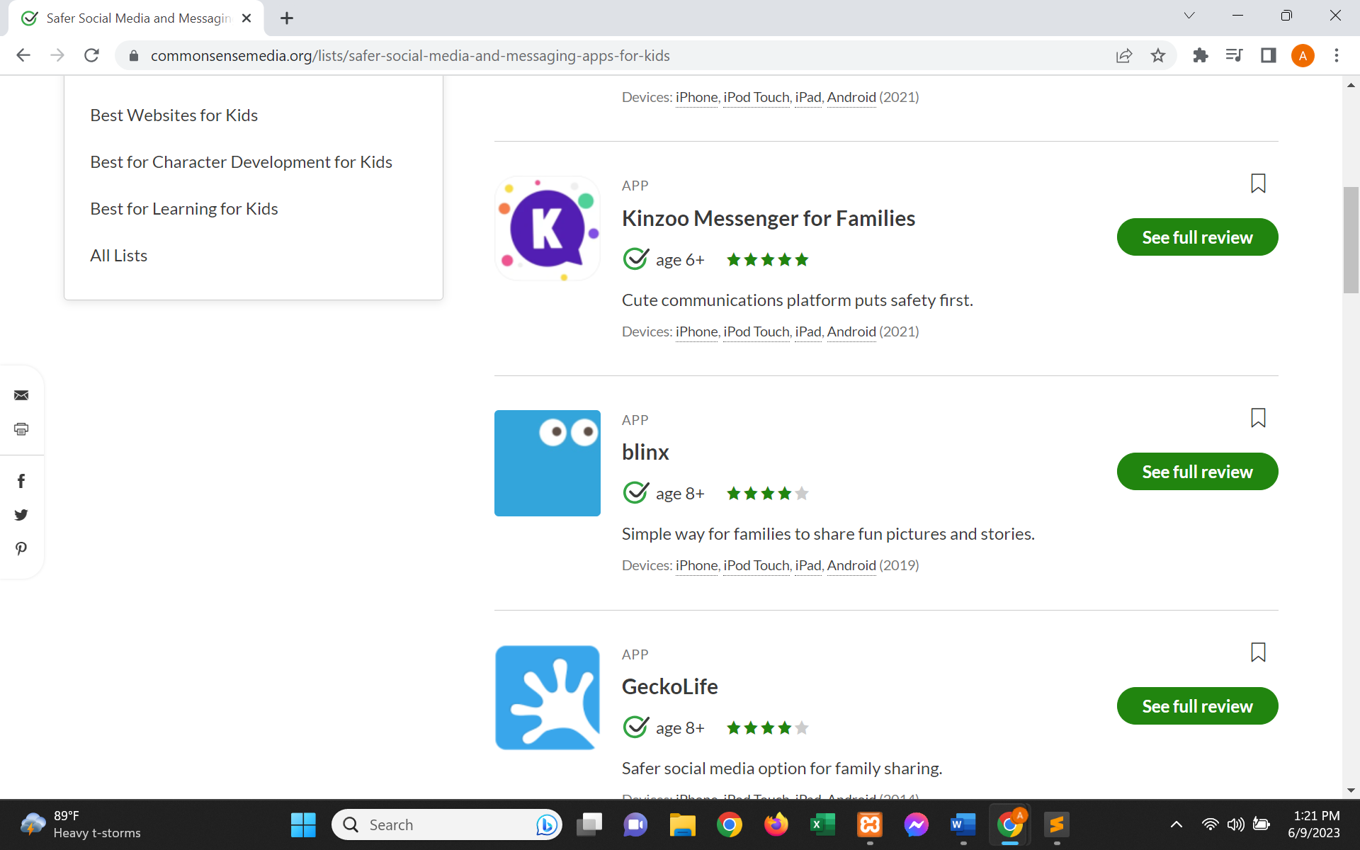
Background Research For our background research we tried finding social media applications for special children in order to find out what kind of social media apps are out there for special children, and what we should we be including in our project.
(1) From our research we found out that there are no specific social media apps for special children, however, we did find social media app for child which are relatively easier and safer to use. These are some of the apps we found through our research. The image below shows examples of such apps. Other than that, we apps like GeckoLife and Cocoon which are also social media apps just for children.
Comparison: No extra features for special children. And includes all the people to whom the struggles and suffering is not exactly relevant.

Slide 5
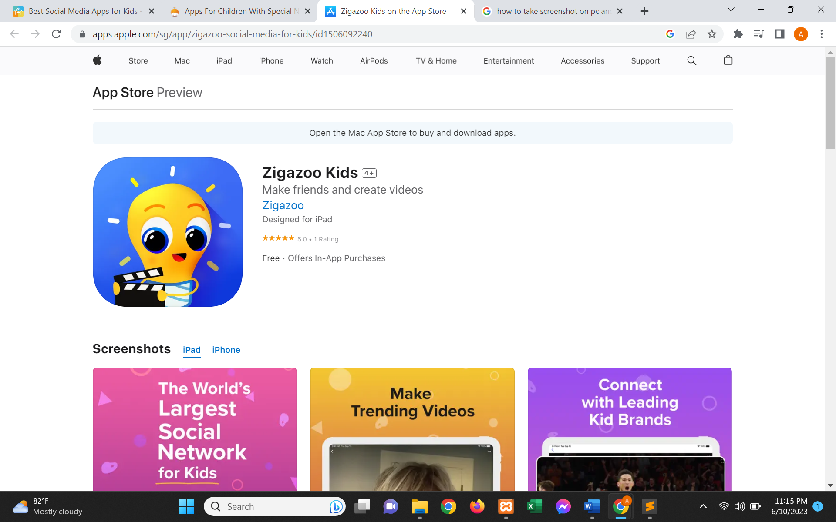
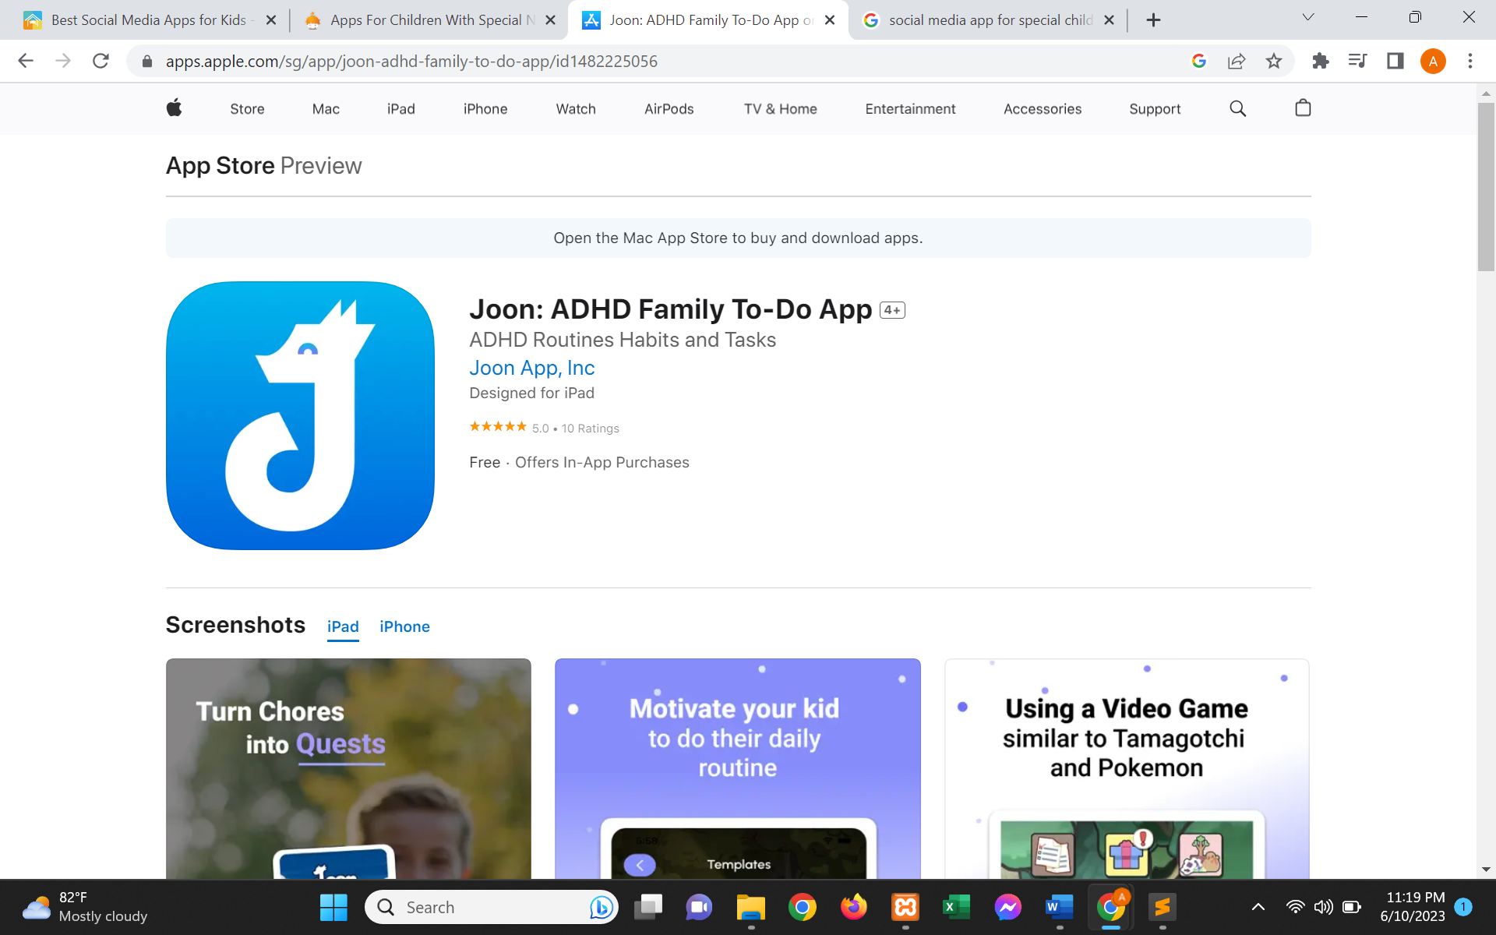
(2) This app in the picture above is one of the top social media apps for children. However, it has no feature for special children. Comparison: No extra features for special children. And includes all the people to whom the struggles and suffering isn’t exactly relevant
(3) Next, we found this app that helps organizing the day-to-day life of families with children with ADHD. However, this app is just more of a refined version of a daily planner.
Comparison: It is a daily tracker so although it has things to do with special children, but it isn’t a social media.

Slide 6
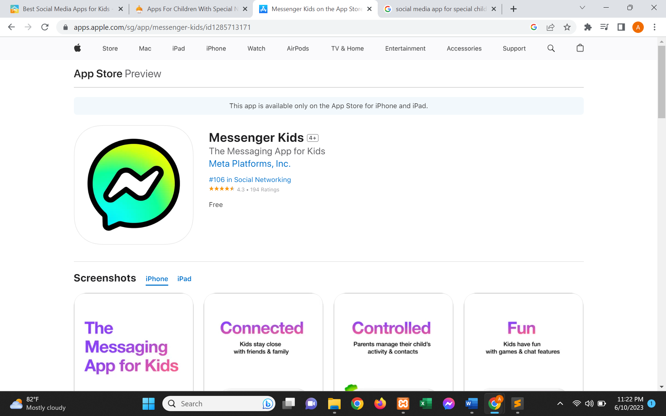
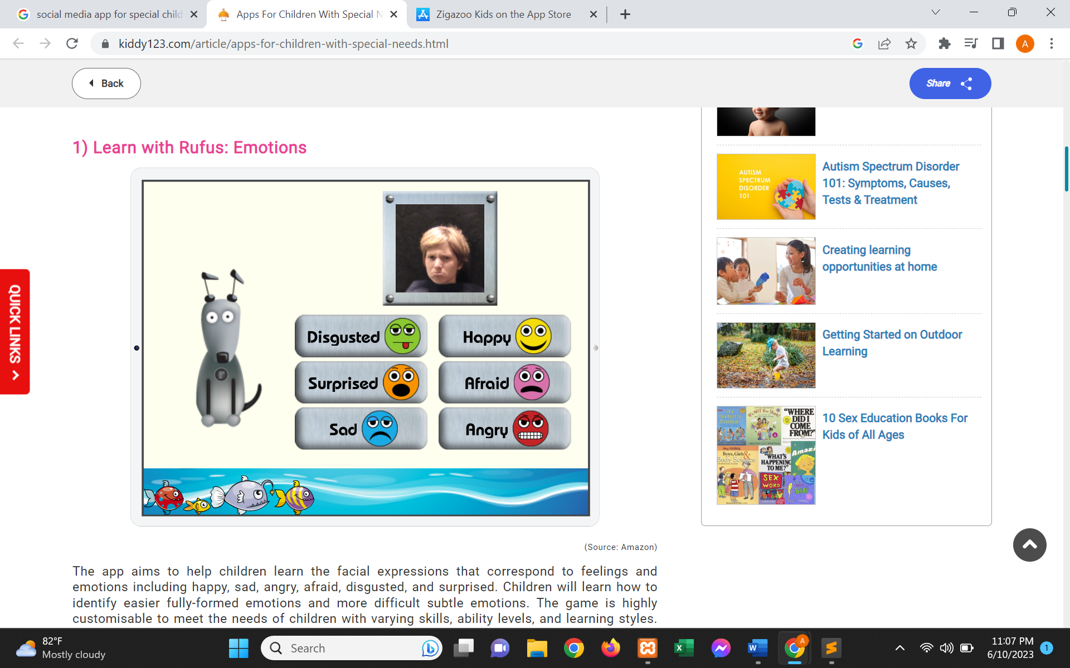
(4) The picture above shows us, the kid version of the social media app we all use today known as messenger. However, it is just the same app as messenger except it has parental control. And the content coming on this app is kid friendly. But this isn’t an app that focuses only on special children. Comparison: No extra features for special children. And includes all the people to whom the struggles and suffering is not exactly relevant.
(5) In the picture above we see an app called “Learn with Rufus”. This app mainly makes special children more familiar with different types of emotions. We have added a feature like this in our project.
Comparison: It isn’t a social media app, however it is an app for children and our project had implanted the mood tracking page from this app.

Slide 7
Background Research(Continued) However, all these existing apps are just an easy means of communication for children. There is no special feature for the special children. So took this matter to our own hand and researched even more to find out features we would like to include in our project. We then further researched more about special children and the things available for then online. We wanted to add links to games for special children, so we found those and included in our project. Other than that, from our research we have found out that, all these special people share their success stories on normal social media app such as Facebook and Instagram. However, it doesn’t reach the correct audience wo would actually feel empowered from their stories. Our goal with our project was to make sure, all these special children and people are getting the features that they could need in one project.

Slide 8
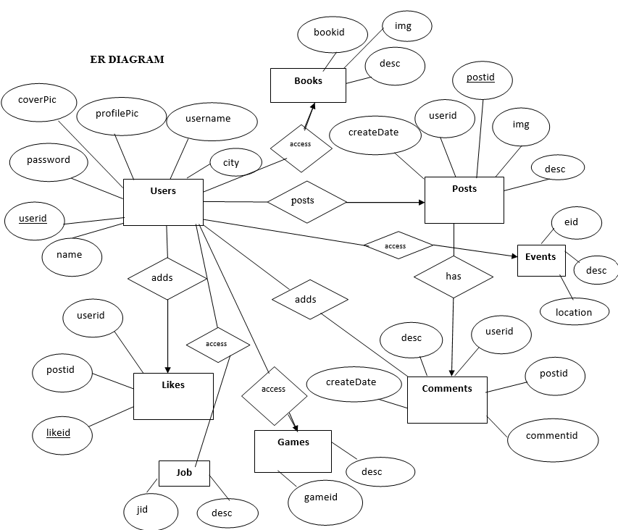
ER DIAGRAM

Slide 9
What Can Our Users See and Access? - Our website firstly has a ‘register’ page and a ‘login’ page. When you enter into our website, you firstly have to register to create an account if an account does not already exist by typing in your name, email, username, password and confirm password. - You will then be redirected to the ‘login’ page, where you need to enter your correct username and password. Without an account, you will not be able to post or access contents of the website. - After login, you are navigated to the ‘home’ page, where you can post about your child and see the other parents’ posts in your timeline. - In the share box, you can write posts about your child and attach images. Once you press the submit button, a post will be made which will be immediately shown in your timeline. - You can access your profile page, and update your information too, as well as follow other parents to be able to like and comment on their posts. - On the side feed, there are several options. Firstly, there is the ‘mood’ section. Next, there is the ‘events’ section. After this, there are the ‘games’ and ‘books’ section where there are information about several games and books. Also, there is the ‘job offerings’ section where job openings and their corresponding details are listed for the special children.

Slide 10
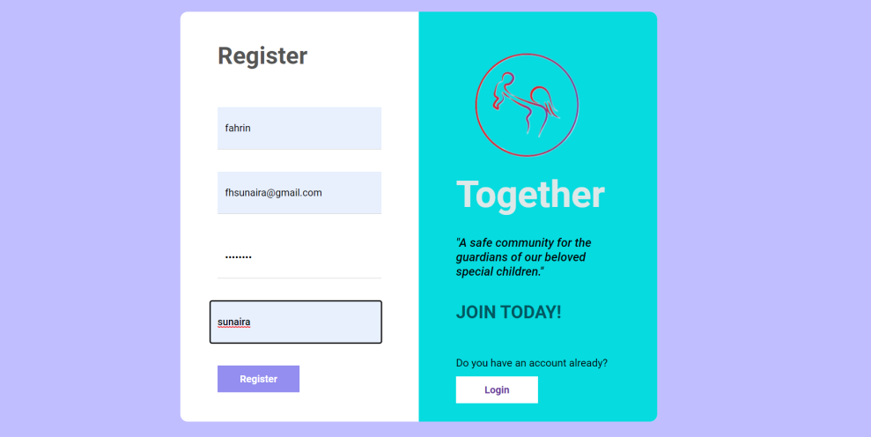
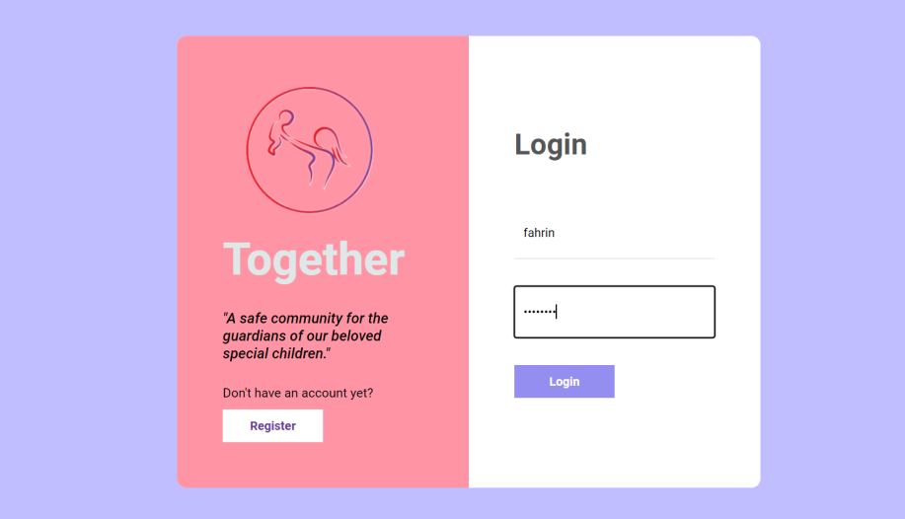
What Can Our Users See and Access(THROUGH IMAGES)?
Register Page
Login Page

Slide 11
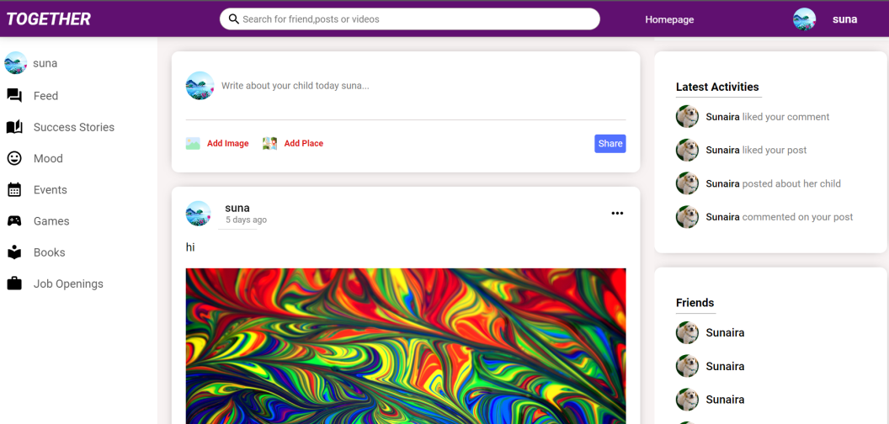
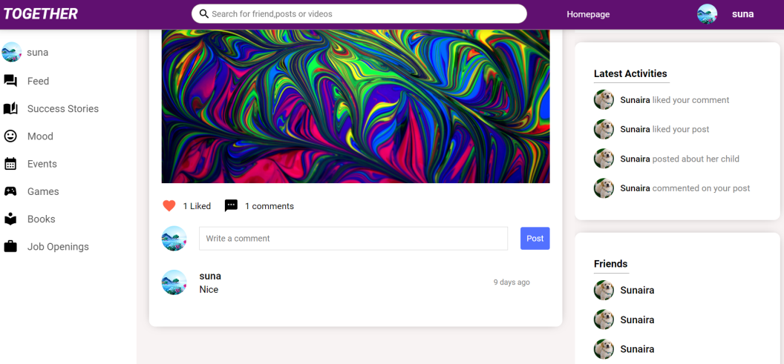
Home Page + Posts
Likes, Comments availability

Slide 12
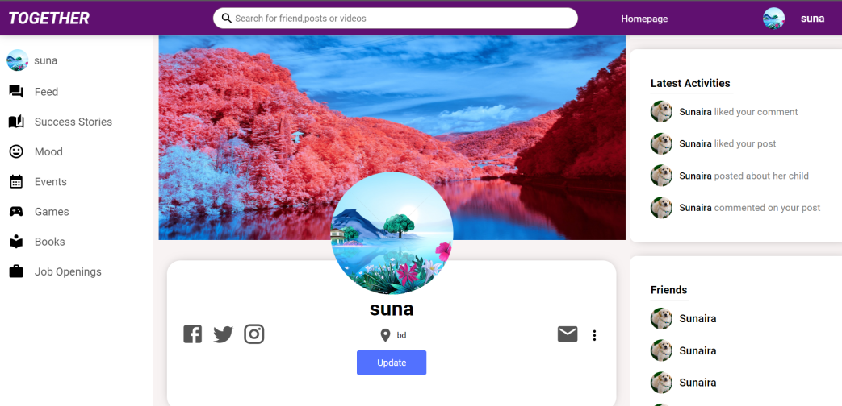
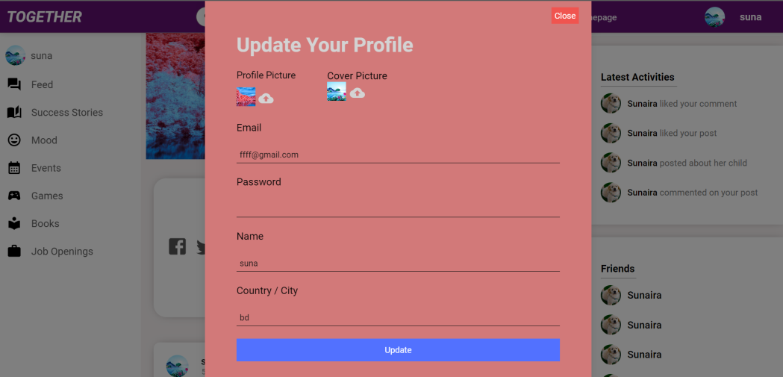
Parent’s Profile Page
Profile Page Editing

Slide 13
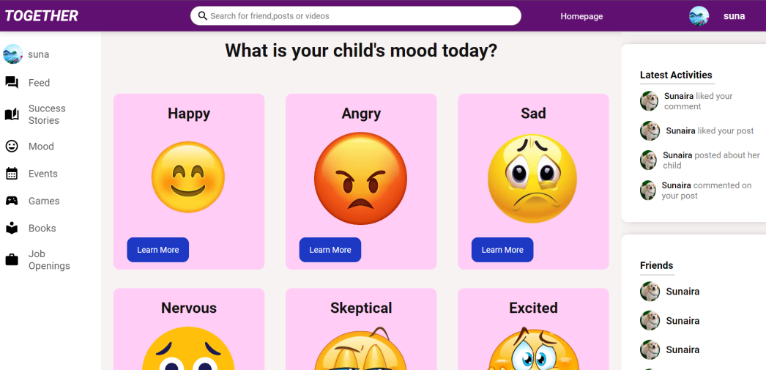
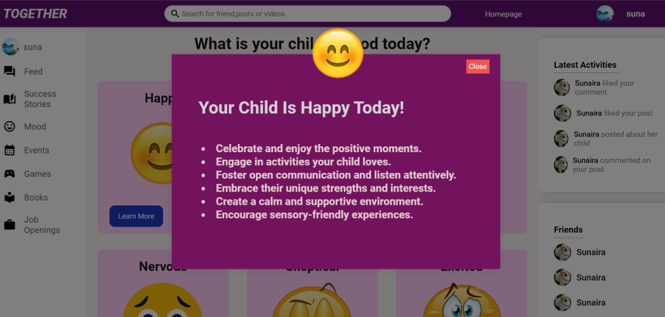
Mood Status
What to do for specific moods?

Slide 14
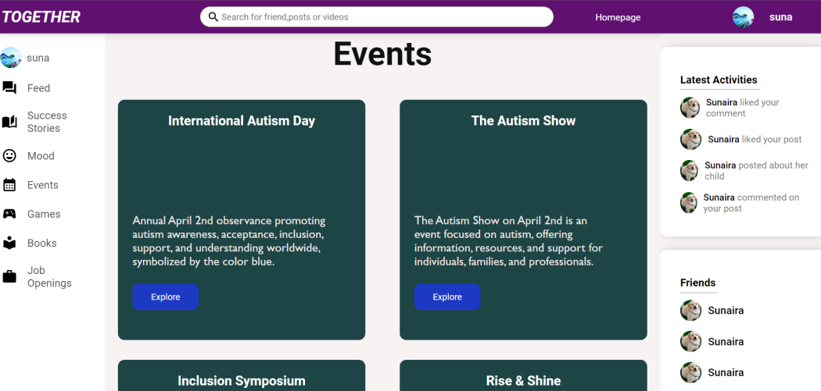
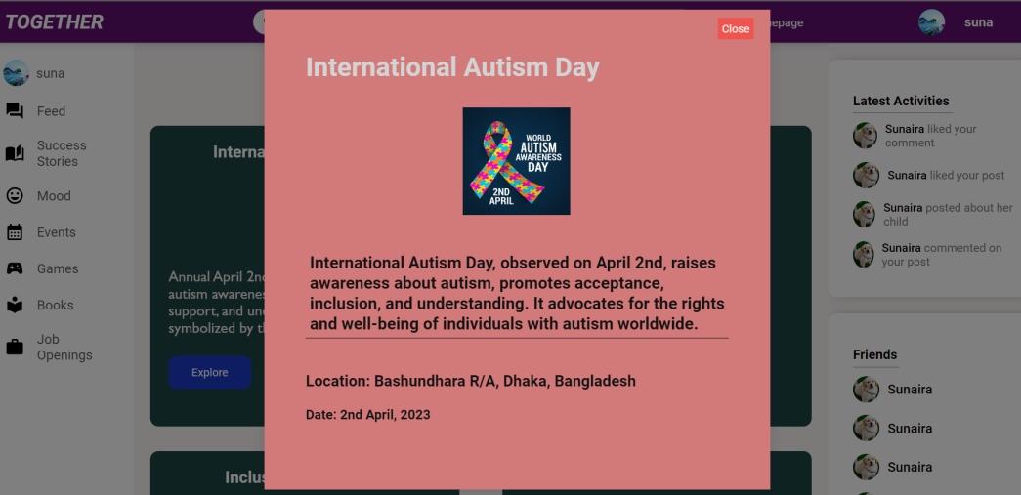
Event Calendar
More details about email

Slide 15
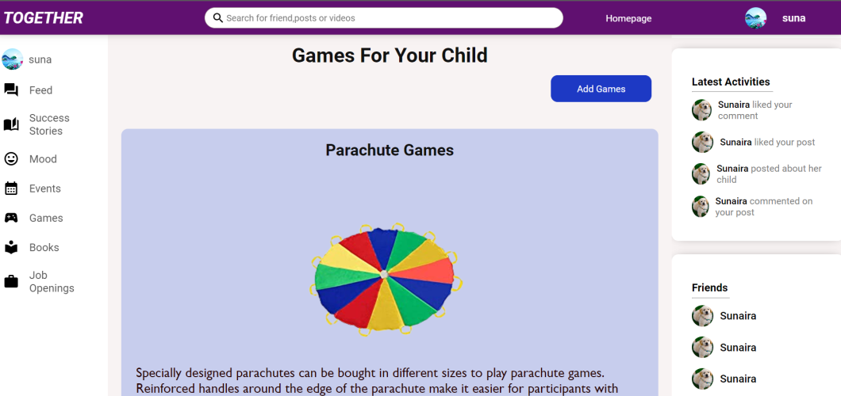
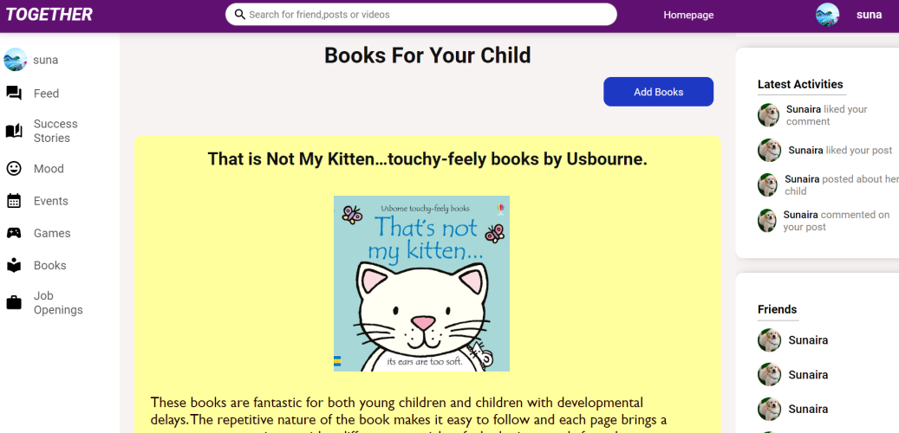
Games
Books

Slide 16
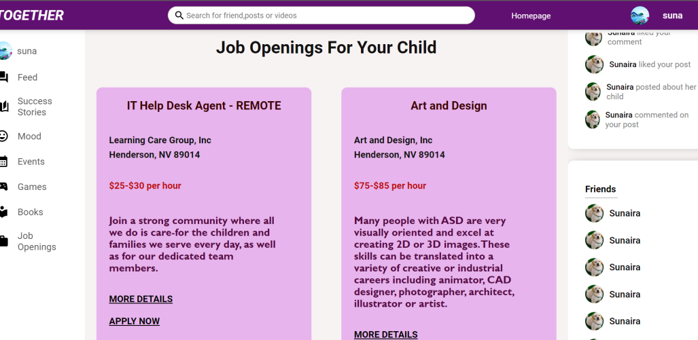
Job Openings

Slide 17
TOOLS USED: - For Frontend: JavaScript, ReactJS, CSS - For Backend: Node.js - Database Server: MySQL Workbench - Text Editor: Visual Studio Code - Tools: GitHub Availability: The link to the GitHub repository: GitHub : https://github.com/Sunaira1101/CSE299_PROJECT/tree/sunaira

Slide 18
Non-technical Issues and Solutions: The major non-technical constraints/issues that we faced was time constraint. Juggling between other courses, it was extremely hard to find time to implement our website. The backend part was extremely time consuming, since a simple error could lead to the whole website non-functional. So, debugging took a lot of our time too. Technical Issues and Solutions: -We did not face any technical problems while designing the frontend part, and developing user interface and user experience. -As the website will involve personal information and sensitive content shared by parents, ensuring robust data security and privacy measures was of utmost importance for us, for which we implemented secure authentication, encryption of passwords, without which we would have faced major technical problems later on.

Slide 19
FUTURE DIRECTION: Our project has the capability to be improved a lot in the future. - Firstly, we want to optimize the website for different screen sizes and devices to ensure a seamless experience across desktop, mobile, and tablet devices. - Secondly, we want to deploy our design into a mobile app too, which would give users more access to our website, and would be easier to browse through information. - Thirdly, we want to add in a section about ‘doctors’ where the parents can get live consultation about their child, and can schedule appointments with doctors from different hospitals, and get proper diagnosis too. They can also consult with therapists, both for them and their child. - Next, we want to add private messaging, forums, and support groups where parents can connect, share experiences, and seek advice from one another in a safe and moderated environment. We need to engage with parents, professionals, and specialists to understand the specific needs and pain points of the children. This can help uncover opportunities for innovative features that differentiate our website from existing platforms and better cater to the needs of parents of special children in the near future.

Slide 20
CONCLUSION: As a conclusion, we can say that our Social Media Website for Special Children project has the potential to make a significant impact on the lives of parents with special children and the broader society. By creating a dedicated online platform, the project aims to address the challenges faced by parents and provide them with a supportive community, access to information and resources, networking opportunities, and a platform to celebrate their child's achievements. In the near future, our project's success can be measured by the active participation of parents, the growth of the online community, and the positive feedback received from users. As parents connect, share their experiences, and support one another, the project fosters a sense of belonging and reduces feelings of isolation. All in all, we can say that our Social Media Website for Special Children project offers a vital platform for parents to connect, share, learn, and celebrate the unique journeys of their children, so hopefully our project can make a meaningful impact on the lives of special children, their families, and the larger community in the near future.

